Slide 1

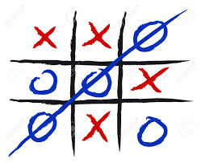
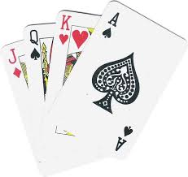

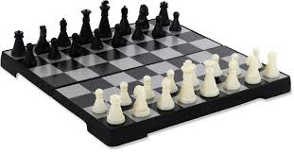





Adversarial Search
Strategic And Stochastic Environment
Everybody has a game plan, but the plan changes after the first punch.

Slide 2
Outline
Types of Games
Heuristics and tactics used in games
Optimal decisions – Mini-max algorithm
α-β pruning algorithm
Imperfect, real-time decisions

Slide 3
Games Terminology
Multi-agent environments
Game theory, a branch of economics
cooperative or competitive environment
Deterministic, turn-taking, two-player, zero-sum games of perfect information
Game tree
Optimal decisions (win, draw, loss)
Best Moves or Killer Moves
Perfect information Vs Imperfect information

Slide 4
Games as a Search Problem
S0: The initial state, which speciﬁes how the game is set up at the start.
PLAYER(s): Deﬁnes which player has the move in a state.
ACTIONS(s): Returns the set of legal moves in a state.
RESULT(s, a): The transition model, which deﬁnes the result of a move.
TERMINAL-TEST(s): A terminal test, which is true when the game is over and false TERMINAL TEST otherwise. States where the game has ended are called terminal states.
UTILITY(s,p): Autility function (also called an objective function or payoff function), deﬁnes the ﬁnal numeric value for a game that ends in terminal state s for a player p. In chess, the outcome is a win, loss, or draw, with values +1, 0, or1 2.

Slide 5
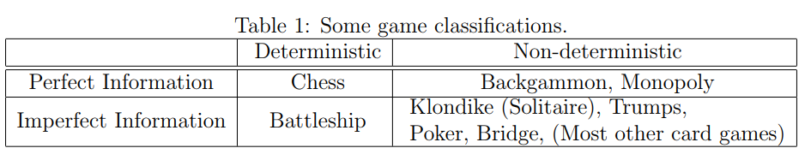
Games Classification
ZERO SUM GAMES
RPG – Role Playing Games
Simulations
Strategic
Mind Game or Puzzle Games
Real Time Game
Multi-agent cooperative and competitive games
Actions Games
And many more

Slide 6
Games
Genre(s) | Paper-and-pencil game
Players | 2
Setup time | Minimal
Playing time | ~1 minute
Random chance | None
Skill(s) required | Strategy, tactics, observation
Synonym(s) | Noughts and crosses Xs and Os

Slide 7
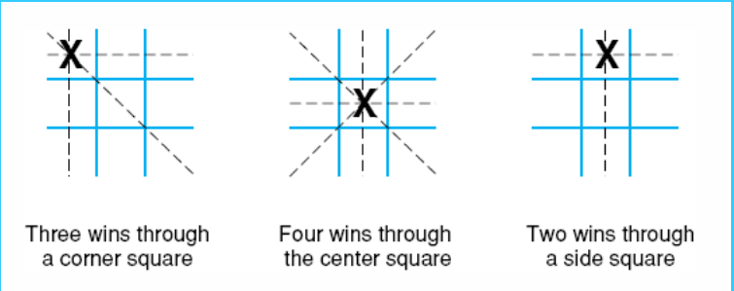
Games

Slide 8
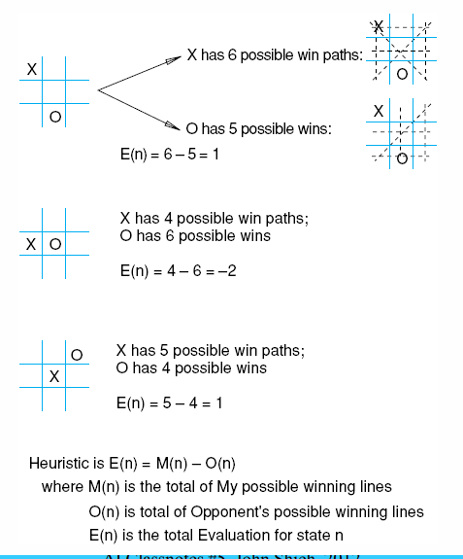
Games

Slide 9
Games
+100 for each three-in-a-row for the AI
+10 for each two-in-a-row (and empty cell) for the AI
+1 for each one-in-a-row (and two empty cells) for the AI
-1 for each one-in-a-row (and two empty cells) for the other player
-10 for each two-in-a-row (and empty cell) for the other player
-100 for each three-in-a-row for the other player
0 for all other states

Slide 10
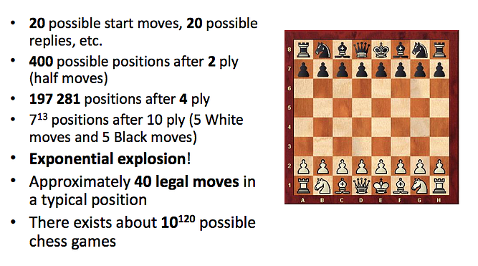
Games

Slide 11
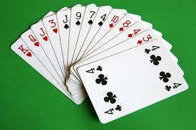
Games
Partially observable environment
Stochastic / Probabilistic Environment
Static Environment

Slide 12
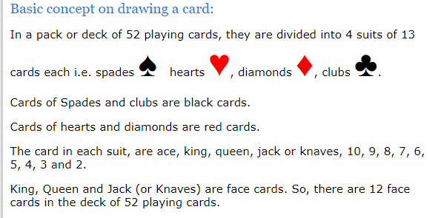
Games

Slide 13
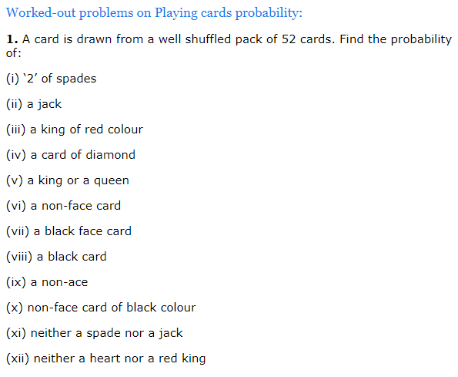
Games

Slide 14
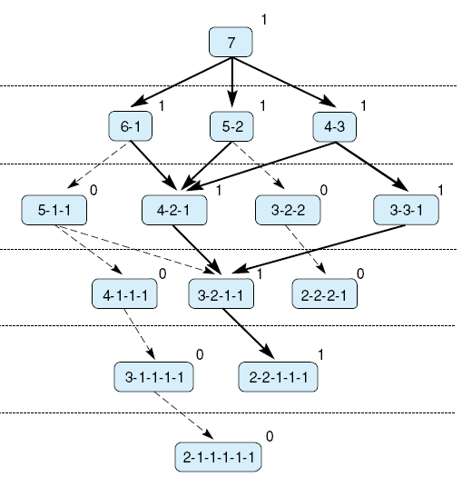
Game of Nim

Slide 15
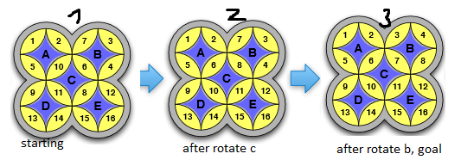
Games
Deterministic Mind Game
Single Player

Slide 16
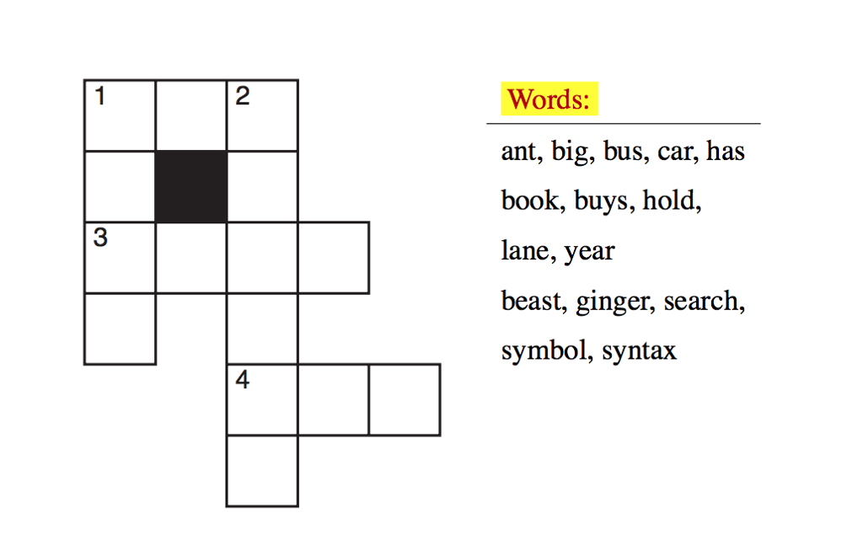
Games
Deterministic Mind Game
Single Player

Slide 17
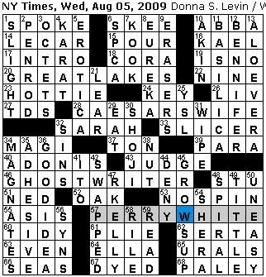
Games – Cross Word Puzzle
Deterministic Mind Game
Single Player

Slide 18
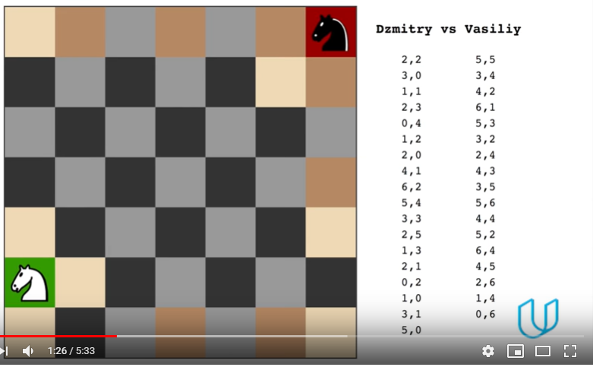
Games – Agent Isolation

Slide 19
Games vs. search problems
"Unpredictable" opponent → specifying a move for every possible opponent reply
Time limits → unlikely to find goal, must approximate

Slide 20

Game tree (2-player, deterministic, turns)

Slide 21
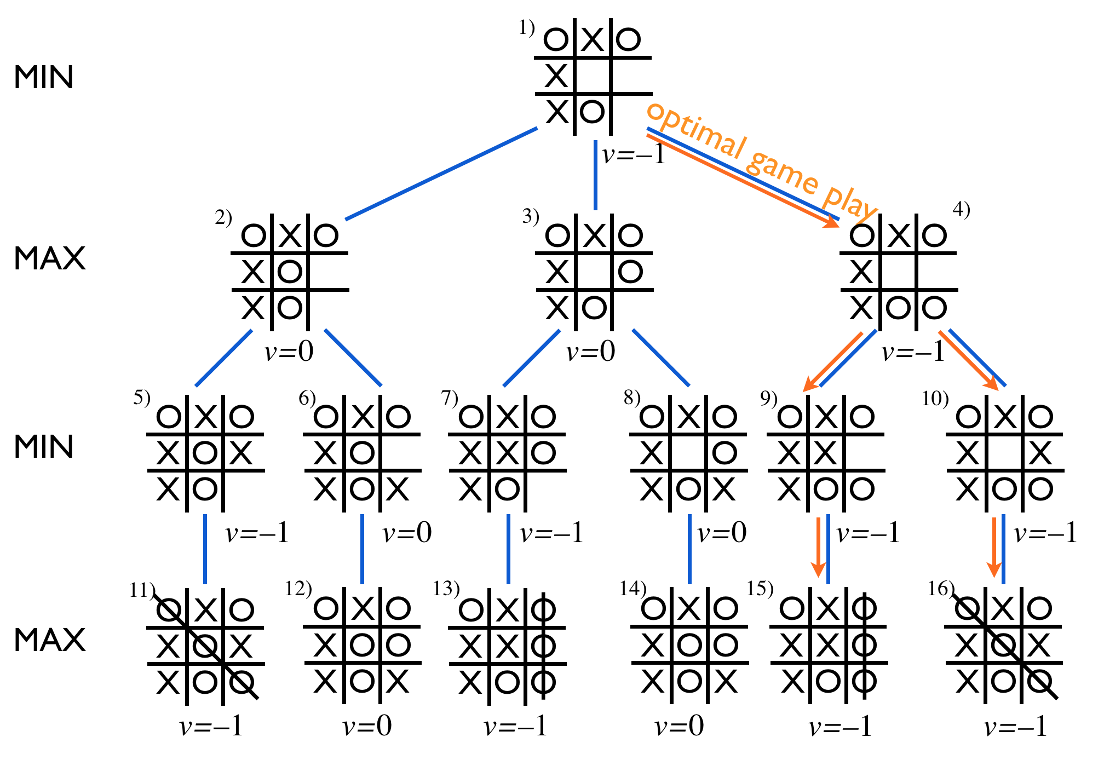
Game tree (2-player, deterministic, turns)

Slide 22

Minimax
Perfect play for deterministic games
Idea: choose move to position with highest minimax value
= best achievable payoff against best play
E.g., 2-ply game:

Slide 23

Minimax algorithm

Slide 24
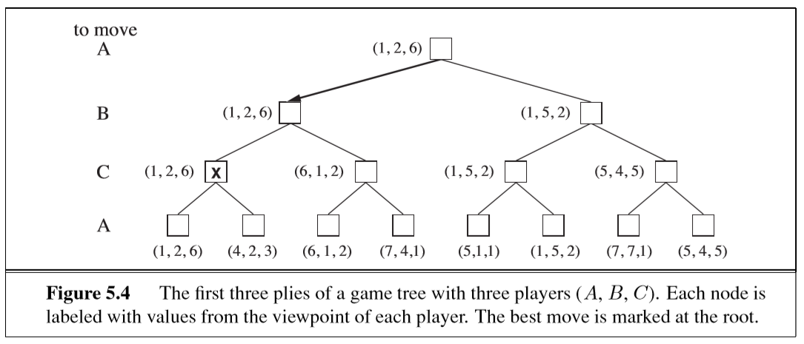
Minimax Optimal Decision in Multi-player Games

Slide 25
Properties of minimax
Complete? Yes (if tree is finite)
Optimal? Yes (against an optimal opponent)
Time complexity? O(b^{m})
Space complexity? O(bm) (depth-first exploration)
For chess, b ≈ 35, m ≈100 for "reasonable" games
→ exact solution completely infeasible

Slide 26

α-β pruning example

Slide 27

α-β pruning example

Slide 28

α-β pruning example

Slide 29

α-β pruning example

Slide 30

α-β pruning example

Slide 31
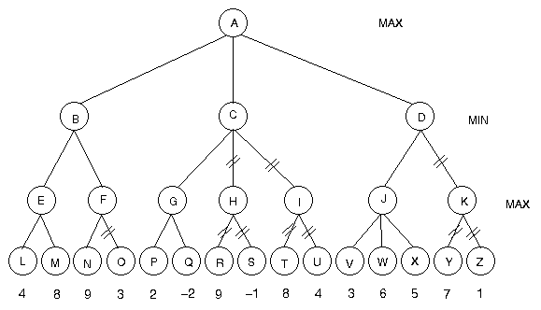
α-β pruning example

Slide 32
Properties of α-β
Pruning does not affect final result
Good move ordering improves effectiveness of pruning
With "perfect ordering," time complexity = O(b^{m/2})
  → doubles depth of search
A simple example of the value of reasoning about which computations are relevant (a form of metareasoning)

Slide 33

Why is it called α-β?
α is the value of the best (i.e., highest-value) choice found so far at any choice point along the path for max
If v is worse than α, max will avoid it
  → prune that branch
Define β similarly for min

Slide 34

The α-β algorithm

Slide 35

The α-β algorithm

Slide 36
Imperfect Real Time Decision
Suppose we have 100 secs, explore 10⁴ nodes/sec
→ 10⁶ nodes per move
Standard approach:
cutoff test:
  e.g., depth limit (perhaps add quiescence search)
evaluation function
  = estimated desirability of position

Slide 37
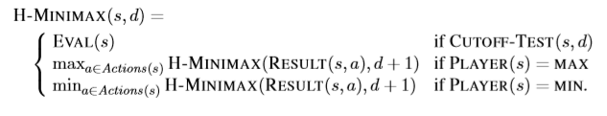
Imperfect Real Time Decision
Alpha beta pruning goes to depth
Not possible in case of huge game trees
But how to calculate utility with out going to terminal
Replace utility function by heuristics evaluation function
Apply Iterative Deepening Search

Slide 38
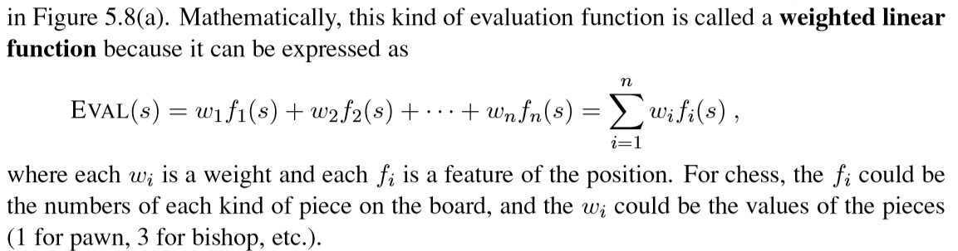
Evaluation functions
For chess, typically linear weighted sum of features
Eval(s) = w₁ f₁(s) + w₂ f₂(s) + … + w_{n} f_{n}(s)
e.g., w₁ = 9 with
f₁(s) = (number of white queens) – (number of black queens), etc.

Slide 39
Cutting off search
MinimaxCutoff is identical to MinimaxValue except
  Terminal? is replaced by Cutoff?
  Utility is replaced by Eval
Does it work in practice?
b^{m} = 10⁶, b=35 → m=4
4-ply lookahead is a hopeless chess player!
  4-ply ≈ human novice
  8-ply ≈ typical PC, human master
  12-ply ≈ Deep Blue, Kasparov

Slide 40
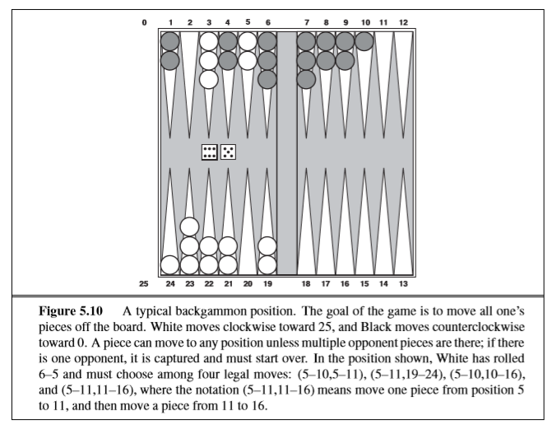
Stochastic Search - Backgammon

